Slide 1
Crisis Communications
Los Angeles Unified School District
Thomas Waldman
Director of Communications & Media Relations

Slide 2
Los Angeles Unified School District
Second-largest school district in the nation.
LAUSD covers an area of 710 square miles.
Student Enrollment: 655,716
Student Characteristics
Languages spoken: 92
Percentage of students who qualify for
free/reduced-priced lunch: 80%
Graduation rate: 65%
Total facilities: 1,278
•Elementary 457 •Middle 86 •High 106 •Special Education 15 •Adult 24
•Early Education 102 •Charter 229 •Magnet 21
•Skills and Regional Occupational Centers 10
School District Employees
Teachers: 27,999
Administrators: 2,098
Support Personnel: 25,959

Slide 3
Crisis Communications
The Los Angeles Unified School District averages three major crises a month. Many, though far from all, are triggered by accusations of inappropriate behavior by teachers and other employees – or by their arrest.
Occasionally, we receive information from law enforcement sources that an arrest is pending, and that a news release will be issued at a certain time. Also, we have a very thorough incident reporting system that we use to determine whether something may attract news media attention.
Communications to parents and guardians are sent via district letters, voice messages and social media channels.

Slide 4
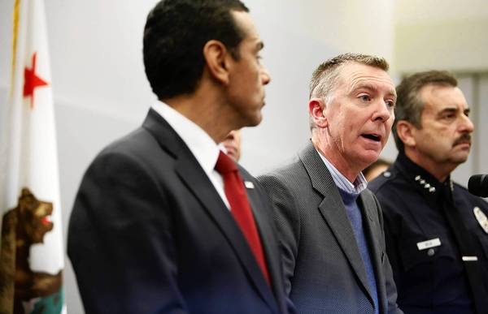
Sandy Hook Statement from Dr. Deasy
Over the past few days, numerous LAUSD parents have inquired about school safety. Understandably, they seek reassurances that we are dedicated to the security of their children, and that we are mindful of any lessons that can be learned stemming from the Newtown tragedy.

Slide 5
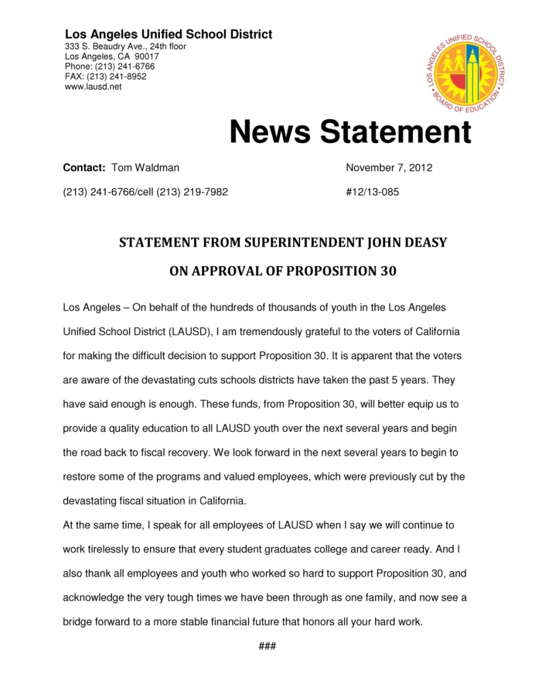
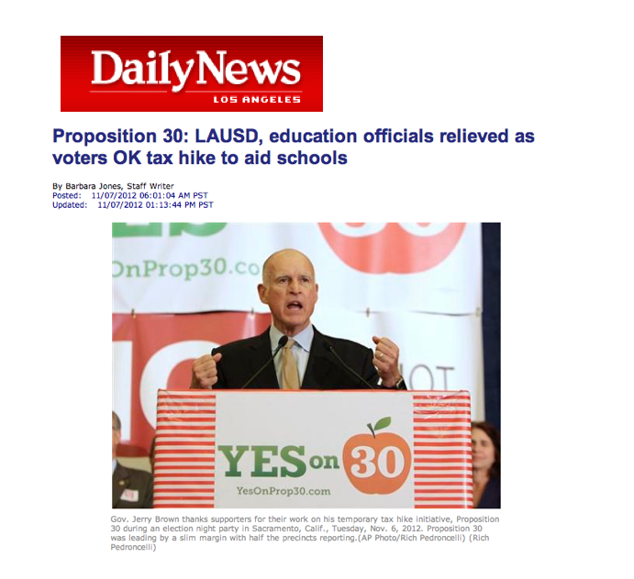
Passage of Proposition 30
Passed by 55% of voters.
Restored current school calendar to 180 instructional days.
Rescinded furlough days for employees.
Maintained funding for free/reduced breakfast and lunch.
Prevented further teacher layoffs.

Slide 6
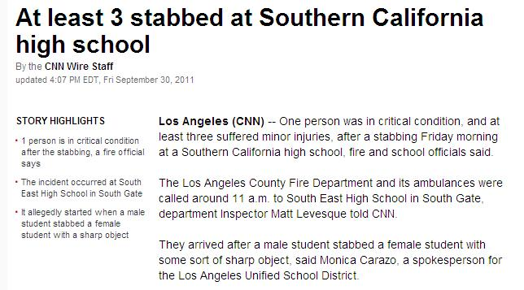
South East High School Stabbing

Slide 7
Facilities Employee, Former Priest
Monday, February 4, a crush of reporters reacting to a story in the Sunday newspaper inquired about the District’s hiring of an ex-priest who had admitted sexual misconduct with a minor before he was defrocked to work not as a teacher but in community outreach for our facilities department.

Slide 8
Reflection
Maintain decorum with reporters.
Try as much as possible to work in accordance with media.
Establish your own priorities.
Take nothing personally.

